Slide 1
Software Testing
UNIT 4

Slide 2
Coding
Programming practice
Top down and Bottom up
Structured programing
Internal Documentation
Verification
Code Reading
Static Analysis
Code Inspection or reviews
Unit Testing
Fundamentals
Functional Testing vs Structural testing coding

Slide 3
Coding
Coding is what makes it possible for us to create computer software, apps and websites. The coding phase is the longest phase in the software development life cycle.
Coding usually begins after the documentation of the design is finalized. This phase will almost entirely involve the work of the developer.
The coding phase of the software life-cycle is concerned with the development of code that will implement the design.
This code is written in a formal language called a programming language.

Slide 4
PROGRAMMING PRACTICES
General coding guidelines provide the programmer with a set of best practices which can be used to make programs easier to read and maintain.
Line Length
It is considered good practice to keep the lengths of source code lines at or below 80 characters. Lines longer than this may not be displayed properly on some terminals and tools. Some printers will truncate lines longer than 80 columns.
Spacing
The proper use of spaces within a line of code can enhance readability.
A keyword followed by a parenthesis should be separated by a space.
● A blank space should appear after each comma in an argument list.
● All binary operators except “.” should be separated from their operands by
spaces.
● Blank spaces should never separate unary operators such as unary minus,
increment (“++”), and decrement (“—”) from their operands.
● Casts should be made followed by a blank space.

Slide 5
Wrapping Lines
When an expression will not fit on a single line, break it according to these following principles:
Break after a comma
Break after an operator
Prefer higher-level breaks to lower-level breaks
Align the new line with the beginning of the expression at the same level on the previous line.
Variable Declarations
Variable declarations that span multiple lines should always be preceded by a type.
Acceptable:
int price , score ;
.

Slide 6
Program Statements
Program statements should be limited to one per line. Also, nested statements should be avoided when possible
Use of Parentheses:
It is better to use parentheses liberally. Even in cases where operator precedence unambiguously dictates the order of evaluation of an expression, often it is beneficial from a readability point of view to include parentheses anyway.
Inline Comments
Inline comments promote program readability. They allow a person not familiar with the code to more quickly understand it. It also helps the programmer who wrote the code to remember details forgotten over time. This reduces the amount of time required to perform software maintenance tasks.

Slide 7
Top-Down Approach
A top down approach is also known as step-wise design approach.
A top down approach simply refers to the “decomposition” means breaking down a component into sub-components/sub-parts.
In the top down approach, testing takes place from top to the bottom which follows the control flow or architectural structure of the software system.
Top down approach is a integration testing where top-level modules tested first and then lower-level modules are tested in a step by step manner until all the modules are not tested.
In this approach, only the top most module is tested separately after that all the lower level modules are combined one by one and tested to ensure that the system is working as expected. This process is repeated until all the modules are combined and tested.

Slide 8
Advantages of Top-down Approach
Fault Localization is easier.
In the top-down approach, critical modules are evaluated on priority and major design flaws could be detect and fixed first .
Top down approach requires few or no drivers.
It is still very successful for functional programming
Easy to maintain, because of this subsystem partitioning
It works very well for small projects, by laying out specific ‘tasks’ to be done.

Slide 9
Bottom Up Approach
This approach is also known as “inductive reasoning” and the term refers to the synthesis.
Bottom-Up Approach is an integration testing in which testing takes place from bottom to up that is lower-level modules are tested first with higher level modules then upper-level modules are tested.
This testing takes help of drivers for testing the software which are the temporary module for integration testing.
Bottom up approach is opposite of top down approach.
It is a type of testing which is used to analyze the risks in the software system or to evaluate that the system works as expected or not.

Slide 10
Advantages of Bottom-Up Approach
Fault localization is easy in this approach.
This testing does not waste time waiting for all modules to be developed.
It is easy to develop test conditions.
This helps to find errors earlier.
Interface defects are detected at early stage
It provides higher accuracy at the granular level.
Observation of test results is easier in this approach.

Slide 11
Difference between Top-Down approach and Bottom-Up approach.
TOP DOWN APPROACH | BOTTOM UP APPROACH
In this approach We focus on breaking up the problem into smaller parts. | In bottom up approach, we solve smaller problems and integrate it as whole and complete the solution.
Mainly used by structured programming language such as COBOL, Fortran, C, etc. | Mainly used by object oriented programming language such as C++, C#, Python.
Each part is programmed separately therefore contain redundancy. | Redundancy is minimized by using data encapsulation and data hiding.
In this the communications is less among modules. | In this module must have communication
In top down approach, decomposition takes place. | In bottom up approach composition takes place.

Slide 12
Structured Programming
In structured programming, we sub-divide the whole program into small modules so that the program becomes easy to understand. The purpose of structured programming is to linearize control flow through a computer program so that the execution sequence follows the sequence in which the code is written. This enhances the readability, testability, and modifiability of the program. This linear flow of control can be managed by restricting the set of allowed applications construct to a single entry, single exit formats.
Why we use Structured Programming?
We use structured programming because it allows the programmer to understand the program easily. If a program consists of thousands of instructions and an error occurs then it is complicated to find that error in the whole program, but in structured programming, we can easily detect the error and then go to that location and correct it. This saves a lot of time.

Slide 13
Internal documentation
Internal documentation is one of the kinds of software documents.
When several kinds of software products are developed then not only the executable files and the source code are developed but also several kinds of documents for instance, users’ manual, Software Requirements Specification (SRS) documents, test documents, design documents, installation manual, etc. are also formulated as part of any software engineering process.
All these documents are an essential part of good software development practice.

Slide 14
Good documents are very useful and server the following objectives:
Good documents improve understanding and maintainability of a software product. They decrease the effort and time needed for maintenance.
Use documents assist the users in effectively utilising the system.
Good documents assist in effectively managing the manpower turnover problem.
Even when an engineer leaves the organisation, and a new engineer comes in, he can construct up the required knowledge easily

Slide 15
Verification
● Validation: Are we building the right system?
● Verification: Are we building the system right?
Verification is the process of checking that a software achieves its goal without any bugs. It is the process to ensure whether the product that is developed is right or not. It verifies whether the developed product fulfills the requirements that we have. Verification is Static Testing.
Activities involved in verification:
Inspections
Reviews
Walkthroughs
Desk-checking

Slide 16
Verification activities include:
technical reviews, walkthroughs and software inspections
checking that software requirements are traceable to user requirements
checking that design components are traceable to software requirements
acceptance testing;
audit.

Slide 17
Validation: Validation is the process of checking whether the software product is up to the mark or in other words product has high level requirements.
It is the process of checking the validation of product i.e. it checks what we are developing is the right product. it is validation of actual and expected product. Validation is the Dynamic Testing.
Activities involved in validation:
Black box testing
White box testing
Unit testing
Integration testing

Slide 18
Difference between Verification and Validation
Verification | Validation
It includes checking documents, design, codes and programs. | It includes testing and validating the actual product.
Verification is the static testing. | Validation is the dynamic testing.
It does not include the execution of the code. | It includes the execution of the code.
Methods used in verification are reviews, walkthroughs, inspections and desk-checking. | Methods used in validation are Black Box Testing, White Box Testing and non-functional testing.
It checks whether the software conforms to specifications or not. | It checks whether the software meets the requirements and expectations of a customer or not.

Slide 19
Verification | Validation
It can find the bugs in the early stage of the development. | It can only find the bugs that could not be found by the verification process.
The goal of verification is application and software architecture and specification. | The goal of validation is an actual product.
Quality assurance team does verification. | Validation is executed on software code with the help of testing team.
It comes before validation. | It comes after verification.
It consists of checking of documents/files and is performed by human. | It consists of execution of program and is performed by computer.

Slide 20
Code Reading
Code reading is a technique that concentrates on how to read and understand a computer program.
It is essential for a software developer to know code reading. The process of reading a software program in order to understand it is known as code reading or program reading.
The purpose of reading programs is to determine the correctness and consistency of the code.
In addition, code reading is performed to enhance the software code without entirely changing the program or with minimal disruption in the current functionality of’ the program.
Code reading also aims at inspecting the code and removing (fixing) errors from it.

Slide 21
Static Analysis
Static analysis comprises a set of methods used to analyze the source code or object code of the software to understand how the software functions and to set up criteria to check its correctness.
Static analysis studies the source code without executing it and gives information about the structure of model used, data and control flows, syntactical accuracy, and much more.

Slide 22
Due to this, there are several kinds of static analysis methods, which are listed below.
Control flow analysis
Data analysis
Fault/failure analysis
Interface analysis

Slide 23
Code Inspection and Reviews
This technique is a formal and systematic examination of the source code to detect errors.
During this process, the software is presented to the project managers and the users for a comment of approval.
Before providing any comment, the inspection team checks the source code for errors. Generally, this team consists of the following.
Moderator
Reader
Recorder
Author

Slide 24
Moderator: Conducts inspection meetings, checks errors-, and ensures that the inspection process is followed.
Reader: Paraphrases the operation of the software code. (reader paraphrases meaning - the reader translates the sections of code from a computer language to a commonly spoken language (such as English)).
Recorder: Keeps record of each error in the software code. This frees the task of other team members to think deeply about the software code.
Author: Observes the code inspection process silently and helps only when explicitly required. The role of the author is to understand the errors found in the software code.

Slide 25
The inspection process is carried out to check whether the implementation of the software code is done according to the user requirements
Code Inspections Steps
Planning
Overview
Preparation
Inspection meeting

Slide 26
Planning: After the code is compiled and there are no more errors and warning messages in the software code, the author submits the findings to the moderator who is responsible for forming the inspection team. After the inspection team is formed, the moderator distributes the listings as well as other related documents like design documentation to each team member. The moderator plans the inspection meetings and coordinates with the team members.
Overview: This is an optional step and is required only when the inspection team members are not aware of the functioning of the project. To familiarize the team members, the author provides details to make them understand the code.

Slide 27
Preparation: Each inspection team member individually examines the code and its related materials. They use a checklist to ensure that each problem area is checked. Each inspection team member keeps a copy of this checklist, in which all the problematic areas are mentioned.
Inspection meeting: This is carried out with all team members to review the software code. The moderator discusses the code under review with the inspection team members.

Slide 28
Checklist
There are two checklists for recording the result of the code inspection, namely, code inspection checklist and inspection error list.
The code inspection checklist contains a summary of all the errors of different types found in the software code. This checklist is used to understand the effectiveness of inspection process.
The inspection error list provides the details of each error that requires rework. Note that this list contains details only of those errors that require the whole coding process to be repeated.

Slide 29
Unit Testing
Unit Testing is defined as a type of software testing where individual components of a software are tested.
Unit Testing of software product is carried out during the development of an application.
An individual component may be either an individual function or a procedure. Unit Testing is typically performed by the developer.
In SDLC or V Model, Unit testing is first level of testing done before integration testing.

Slide 30
Objective of Unit Testing:
To isolate a section of code.
To verify the correctness of code.
To test every function and procedure.
To fix bug early in development cycle and to save costs.
To help the developers to understand the code base and enable them to make changes quickly.
To help for code reuse

Slide 31
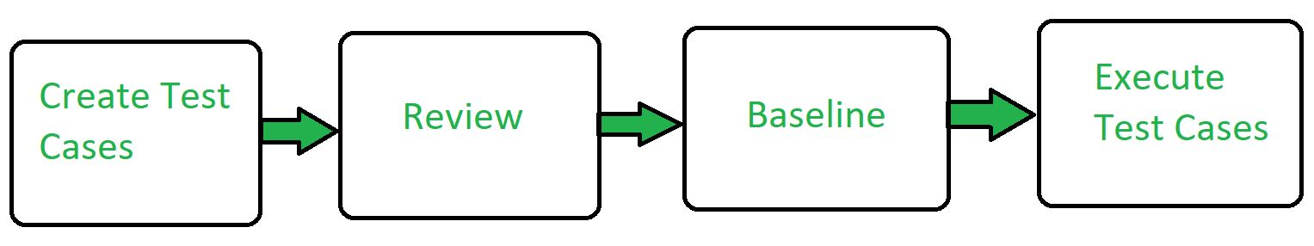
Workflow of Unit Testing:

Slide 32
Unit Testing - Advantages:
Reduces Defects in the Newly developed features or reduces bugs when changing the existing functionality.
Reduces Cost of Testing as defects are captured in very early phase.
Improves design and allows better refactoring of code.
Unit Tests, when integrated with build gives the quality of the build as well.

Slide 33
SOFTWARE TESTING FUNDAMENTALS
Software Testing is a method to check whether the actual software product matches expected requirements and to ensure that software product is Defect free.
Benefits of Testing
● It reveals the errors in the software.
● It ensures that software is functioning as per specifications and it meets all the behavioral requirements as well.
● The data obtained during testing is indicative of software reliability and quality as a whole.

Slide 34
Testing Objectives:
To find any defects or bugs that may have been created when the software was being developed.
To prevent defects in the final product
To increase confidence in the quality of the software
To ensure the end product meets customer requirements as well as the company specifications
To provide customers with a quality product and increase their confidence in the company

Slide 35
FUNCTIONAL TESTING Vs STRUCTURAL TESTING
Black-box testing, also known as functional testing lay emphasis on the functional requirements of the software
It refers to tests that are conducted at the software interfaces; it mainly focuses on the functional requirements of the software.
Black box testing is a technique of software testing which examines the functionality of software without peering into its internal structure or coding. The primary source of black box testing is a specification of requirements that is stated by the customer.
In this method, tester selects a function and gives input value to examine its functionality, and checks whether the function is giving expected output or not.
If the function produces correct output, then it is passed in testing, otherwise failed. The test team reports the result to the development team and then tests the next function.

Slide 36
Steps of Black Box Testing
The black box test is based on the specification of requirements, so it is examined in the beginning.
In the second step, the tester creates a positive test scenario and an adverse test scenario by selecting valid and invalid input values to check that the software is processing them correctly or incorrectly.
In the third step, the tester develops various test cases such as decision table, all pairs test, equivalent division, error estimation, cause-effect graph, etc.
The fourth phase includes the execution of all test cases.
In the fifth step, the tester compares the expected output against the actual output.
In the sixth and final step, if there is any flaw in the software, then it is cured and tested again.

Slide 37
There are different techniques involved in Black Box testing.
Equivalence Partitioning
Boundary Value Analysis
Cause-Effect Technique
Error guessing Technique

Slide 38
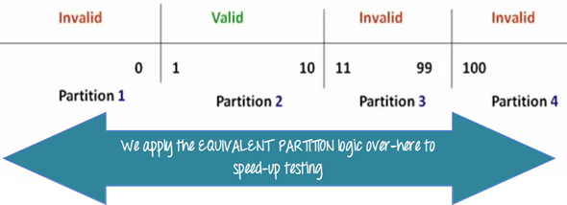
Equivalence partitioning
Equivalence partitioning is a technique of software testing in which input data divided into partitions of valid and invalid values, and it is mandatory that all partitions must exhibit the same behavior.

Slide 39
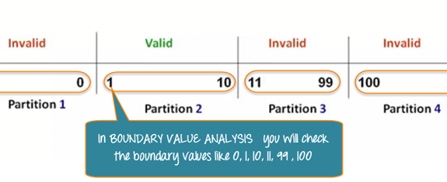
Boundary Value Technique
Boundary Value Technique is used to test boundary values, boundary values are those that contain the upper and lower limit of a variable. It tests, while entering boundary value whether the software is producing correct output or not.

Slide 40
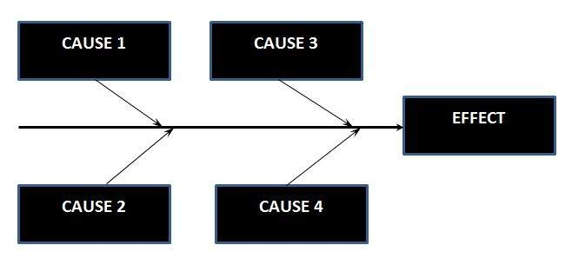
Cause-Effect Technique
Cause-Effect Technique underlines the relationship between a given result and all the factors affecting the result. It is based on a collection of requirements.

Slide 41
Error guessing Technique
Error guessing is a technique in which there is no specific method for identifying the error. It is based on the experience of the test analyst, where the tester uses the experience to guess the problematic areas of the software.

Slide 42
White Box Testing
White box testing which also known as glass box is testing, structural testing, clear box testing, open box testing and transparent box testing.
It tests internal coding and infrastructure of a software focus on checking of predefined inputs against expected and desired outputs.
It is based on inner workings of an application and revolves around internal structure testing. In this type of testing programming skills are required to design test cases.
The primary goal of white box testing is to focus on the flow of inputs and outputs through the software and strengthening the security of the software.
Developers do white box testing. In this, the developer will test every line of the code of the program.

Slide 43
The developers perform the White-box testing and then send the application or the software to the testing team, where they will perform the black box testing and verify the application along with the requirements and identify the bugs and sends it to the developer.
White Box Testing Techniques:
Statement Coverage - This technique is aimed at exercising all programming statements with minimal tests.
Generally in any software, if we look at the source code, there will be a wide variety of elements like operators, functions, looping, exceptional handlers, etc. Based on the input to the program, some of the code statements may not be executed. The goal of Statement coverage is to cover all the possible path’s, line, and statement in the code.

Slide 44
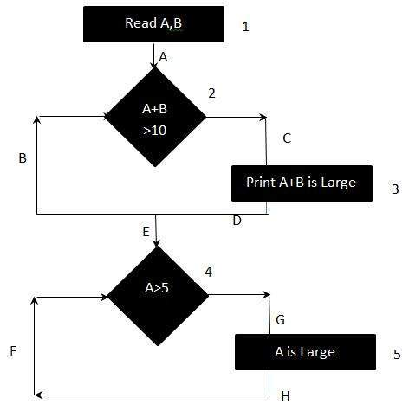
Branch Coverage - Branch coverage is a testing method, which aims to ensure that each one of the possible branch from each decision point is executed at least once and thereby ensuring that all reachable code is executed.

Slide 45
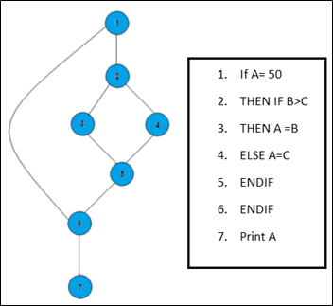
Path Coverage - This technique corresponds to testing all possible paths which means that each statement and branch is covered.

Slide 46
Differences between Black Box Testing vs White Box Testing
Black Box Testing | White Box Testing
It is mostly done by software testers. | It is mostly done by software developers.
No knowledge of implementation is needed. | Knowledge of implementation is required.
It can be referred as outer or external software testing. | It is the inner or the internal software testing.
It is functional test of the software. | It is structural test of the software.
It is not suitable or preferred for algorithm testing. | It is suitable for algorithm testing.

Slide 47
Black Box Testing | White Box Testing
This testing can be initiated on the basis of requirement specifications document. | This type of testing of software is started after detail design document.
No knowledge of programming is required. | It is mandatory to have knowledge of programming.
It is the behavior testing of the software. | It is the logic testing of the software.
It is applicable to the higher levels of testing of software. | It is generally applicable to the lower levels of software testing.
It is also called closed testing. | It is also called as clear box testing.
It is least time consuming. | It is most time consuming.

